Slide 1
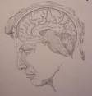
Memory

Slide 2
Memory
A cognitive process for storing and retrieving information.
Process of encoding, storage and retrieval
3 distinct processes
Encoding- converting information into a form that can be entered into memory
Storage- retaining information over varying periods of time
Retrieval- accessing specific info when it is needed

Slide 3
Information Processing Theory
Atkinson & Shiffrin (1968)
3 distinct systems of storing information
Sensory memory- temporary storage of information brought to us by our senses
held for a brief time period- a few seconds
Short Term Memory (working memory)-holds small amount of information for 20-30 seconds
Long -term memory –memory system that permits recall of information about past events or factual information.

Slide 4
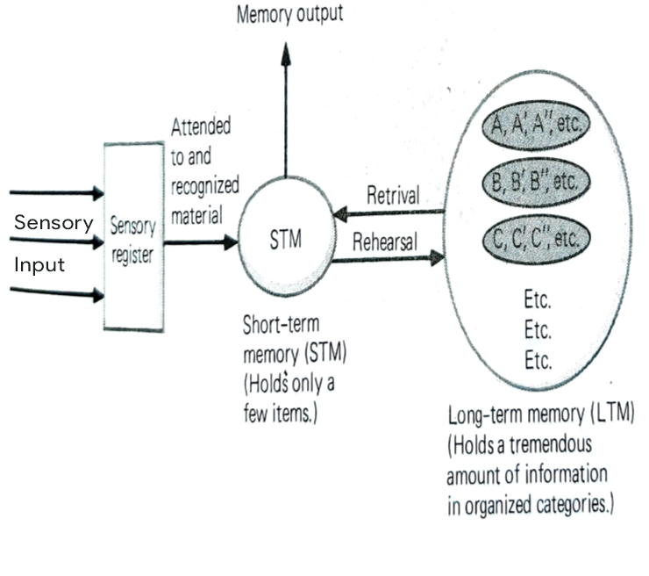
An Information-processing model of memory. (Based on Atkinson and Shiffrin, 1968)

Slide 5
Information moves from one memory system to another because of active control processes that determine which information is retained.
Information in sensory register enters short-term memory when it becomes the focus of our attention.
Selective attention, our ability to focus on some aspects.
Information enters long term memory from short term memory through elaborate rehearsal.
In the absence of cognitive effort information in STM quickly fades away. Mere repetitions do not move information from STM to LTM.

Slide 6
Kinds of memory
Sensory Register- The information held in the sensory channels
The information is lost after being briefly stored
Attended information moves to STM
Visual Sensory Register- 1 sec
Auditory Sensory Register- 4 to 5 sec
Visual sensory register-stores 11 to 16 items
in the form of Iconic Image

Slide 7
Short term memory or Working memory- All the information being used right now is held.
Experiment on free recall. Serial position curve.
Primacy effect
Recency effect
If delay in recall is filled with mental activity will lead to elimination of recency.
Limited storage capacity of about 7 items plus/minus 2
Chunking “process used to remember more items

Slide 8
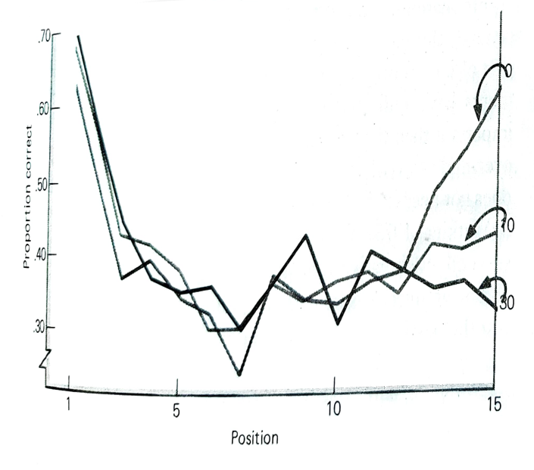
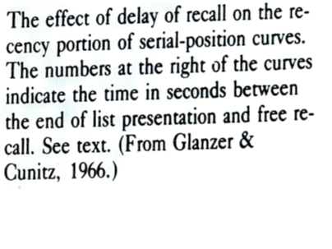

Slide 9
How does working memory operate?
Parts to working memory
A central executive processor involved in decision making and reasoning.
2 distinct storage systems.
Phonological loop that processes information relating to the sounds of words, speech and numbers.
Visuospatial sketch pad that processes visual and spatial information.

Slide 10
Rehearsal- Process shifts information from STM to LTM
Consists of keeping items of information in the centre of attention
Amount of rehearsal important
Mere repetition not adequate
Elaborative rehearsal an active process

Slide 11
Long term memory
Lasts for days/months-no known limit in storage capacity
Factual information is stored and can be brought to conscious awareness and reported verbally.
Consists of episodic memory and semantic memory.
Episodic memory- holds information acquired at a specific time and place. Memory of past experiences.
Semantic memory- holds information of a general nature, meanings of words, properties of objects.

Slide 12
For enhancing recall of information the following factors are important:
amount of practice and spacing practice.
Kind of processing done- working actively on the information , attempting to understand and not mere repetition.

Slide 13
Retrieval cues
Are stimuli available as you search for a particular memory.
May be external eg. Can be questions in a quiz or internal eg. where have I met that person.
Each time a memory is retrieved for a purpose that purpose provides retrieval cues.

Slide 14
Interference
Memories can compete and result in interference with each other.
Proactive interference- information acquired in the past makes it difficult to acquire new information
Retroactive interference- acquisition of new information makes it harder for you to remember older information.
Explanations
Interferences disrupt various kinds of associations between context of coding and retrieval cues.

Slide 15
Craik and Lockhart (1972) - levels of processing
Processes of encoding and retrieval
More deeply information is processed the more likely it is retained.
Shallow processing involves mere repetitions,
Deeper processing means attention to more deeper meaning.
However, it is difficult to specify questions of what constitutes deep versus shallow processing. Also several forms may occur simultaneously.

Slide 16
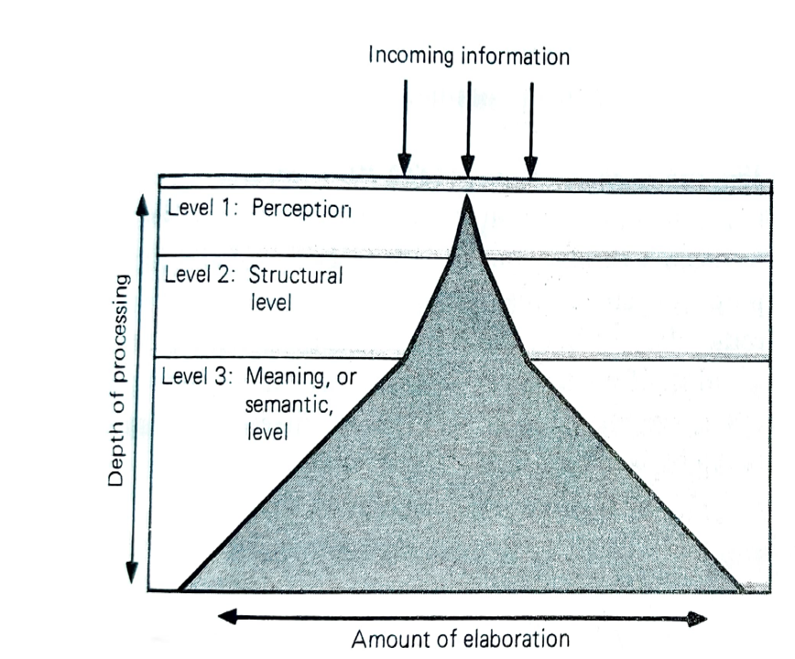
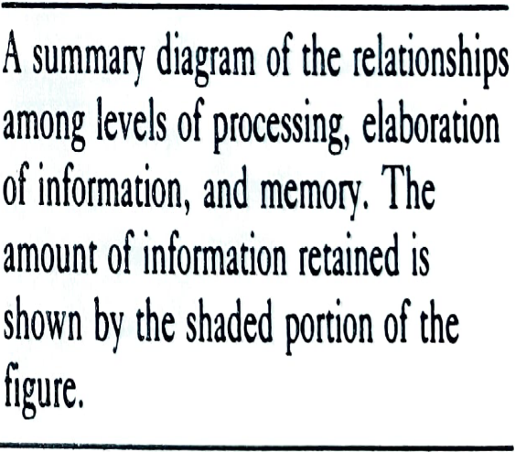

Slide 17
Structures in Long Term Memory
Organizes, categorizes and classifies info.
Concepts and Prototypes
Hierarchies & basic levels
Schemas-knowledge packages.
Tip of the Tongue Phenomenon
- Sounded like the target word
- Started with the same letter
- Contained the same no. of syllables
- Had a meaning similar to the target word

Slide 18
Types of memory
Implicit memory- Memory processes that bring past knowledge to influence the interpretation of new stimuli.
Explicit memory- eg. Learning the word refrigerator when someone brings explicit attention to it.
Most circumstances of encoding & retrieval may have both uses of memory.

Slide 19
Declarative Memory- factual information, names, faces and dates etc
Procedural Memory- memory for skills and habits
Declarative-
Semantic
episodic

Slide 20
Encoding & storage in LTM
Important role of organization: arranging information in already existing categories.
    Memory of words arranged in logical hierarchies better.
    Subjective organization should be provided.
Important role of imagery: Encoding incoming information in imagery.
    Images are the partial altered representations of the world around us.
    Paired-associate technique used. Word pairs with concrete and abstract words. Recall better for concrete words.

Slide 21
Important role of constructive processes:
    Material is simplified, changed hence encoded material is different from original learned material.
    Inferences used; dependent on the already existing schemas.

Slide 22
Retrieval from Long term memory
Retrieval cues assist the getting information from long term memory.
Good when the retrieval is good when rich cues are available.
State dependent memory- information encoded in a particular emotional or drugged state is retrieved easily in the same state. But not otherwise.

Slide 23
Reconstructive Processes in retrieval:
  Modifications of already stored information.
  Difficult to the difference between constructive processes and reconstructive processes.
  Confabultaion- people with memory disorders who have stored very little and then try to fill the memory gaps during retrieval.
  Eyewitness memory-their memories were quite vulnerable to distortions from post-event information.

Slide 24
Forgetting
Refers to apparent Loss of information already encoded and stored in Long Term Memory
“Forgotten” information may never have been encoded & stored
Not reached STM from the sensory register
Or inadequate coding doesn’t move from STM to LTM
Absence of elaborate rehearsal

Slide 25
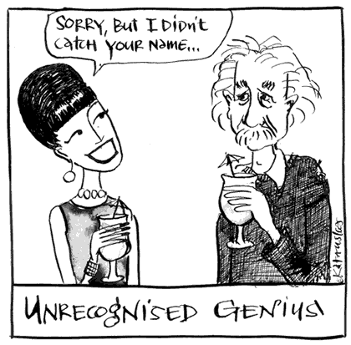
Forgetting
Decay of Memory Trace
“ the Engram”
Interference
Proactive
Retroactive
Study French
Spanish
Test Spanish
Study French
Spanish
Test French
Time

Slide 26

Retrieval Problems
Absence of appropriate retrieval cues
Remember sought for information much after giving up.
Motivated Forgetting
Eg. Repression tendency of people to have difficulty in retrieving anxiety- provoking or threatening information, or related information from LTM.

Slide 27
Amnesia-It is profound memory loss due to loss of already encoded information or inability to retrieve it.
Retrograde-
Memory is lost for occurrences prior to a certain event.
lost memories gradually appear
Though full restoration can take years
Anterograde-
Injuries cause transfer from STM to LTM affected.

Slide 28
Psychological Amnesia
Childhood Amnesia
Freud provides repression of guilt provoking sexual & aggressive urges
Schachtel- absence of language non verbal
Brain is still developing
Dream Amnesia
  Dreams according to Freud’s interpretation are expressions of forbidden sexual & aggressive urges.
  Symbol systems used in dreaming and waking
Defensive Amnesia-
Attempt to protect oneself from guilt and anxiety that leads to intolerable life situations

Slide 29
Biological amnesia
Transient global amnesia- both retrograde amnesia and anterograde amnesia happen. Disruption in the normal blood supply to the brain.
Effects of drugs & alcohol- loss of memory of experiences during the alcoholic or drugged state.
Korsakoff syndrome of alcoholics; characterized by anterograde amnesia.

Slide 30
Senile Dementia- Deficits in many intellectual abilities- memory, attention, judgment
Personality changes
Delusions
Largely anterograde
Provide retrieval cues
Alzheimer’s Disease-
Severe memory problems
Starts as simple forgetfulness
Memory loss more profound
Even simple tasks forgotten
Deterioration gradually includes loss of abilities to speak or comprehend language
Physical deterioration leads to death

Slide 31
Improving your memory
The Method of Loci
Memory pegs are parts of your image of a scene.
Rehearse the image
Make as many associations with parts of the “room” or aspects of the image.
Number of letter pegs- distinctive images of words that start with the sounds of first alphabet.

Slide 32
Mnemonics-
Techniques that rely on linking, or association of to-be-remembered material with a systematic and organized set of images or words, already establishes in LTM.
-This works as reminder cues.
HOMES
Huron, Ontario, Michigan, Erie & Superior
Stories , Remembering Names and Faces, Chunking

Slide 33
Flashbulb Memory
Memories of a specific, important, or surprising event that are so vivid, they are like a snapshot of the event.
Do not contain every detail of an original scene.
Distinctive stimulus retrieved easily.

Slide 34
Different parts of the brain & memory
Cerebellum- essential for procedural memory, acquired by repetition & classical conditioning.
Striatum- complex structures in the forebrain; place for habit formation.
Cerebral cortex- responsible for sensory memories and association between sensations.
Amygdala & hippocampus- declarative & emotional significance.

